Slide 1
Regional Standards for Nitrogen and Phosphorus in Wastewater Discharges
Maurice J. Narcis, PhD
Institute of Marine Affairs
18th March, 2025
Joint Monitoring and Assessment Open Ended Working Group and Sargassum Working Group Meeting/Workshop

Slide 2
Cartagena Convention
The Convention for the Protection and Development of the Marine Environment of the Wider Caribbean Region (WCR) is a regional legal agreement for the protection of the Caribbean Sea. Adopted in Cartagena, Colombia on 24 March 1983 and entered into force on 11 October 1986.
Supported by Technical Agreements or Protocols
Oil Spills
Specially Protected Areas and Wildlife (SPAW)
Land Based Sources of Pollution (LBS)

Slide 3
LBS Protocol - Annexes
Annex I establishes a list of land-based sources and activities and their associated contaminants of greatest concern to the marine environment;
Annex II outlines and establishes the process for developing regional standards and practices for the prevention, reduction, and control of the sources and activities identified in Annex I.
Annex III establishes specific regional effluent limitations for domestic sewage;
Annex IV requires each Contracting Party to develop plans, programmes and other measures for the prevention, reduction and control of agricultural non-point sources of pollution

Slide 4
Nutrient Pollution
Land based activities are mostly responsible for pollution of the marine environment that adversely impacts our marine ecosystems and their ecosystem services.
Agricultural runoff, domestic wastewater, untreated sewage, industrial discharges, and atmospheric releases from fossil fuel combustion are the main anthropogenic sources of nutrients to the marine environment

Slide 5
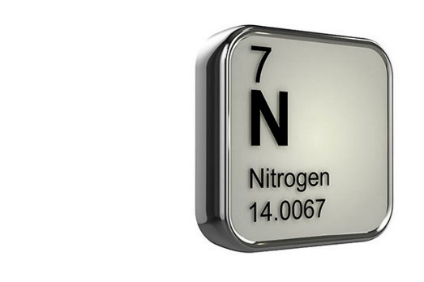
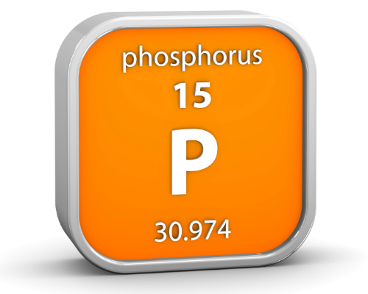
Nitrogen and Phosphorus
Different forms of nitrogen and phosphorus compounds include nitrate, nitrite, ammonia, organic nitrogen (in the form of plant material or other organic compounds), and phosphates (orthophosphate and others).
Nitrate is the most common form of nitrogen and phosphates are the most common forms of phosphorus found in natural waters

Slide 6
Nutrients in Coastal Waters

Slide 7
Eutrophication
The increase in nutrients to freshwater or marine systems, which leads to increases in plant growth and often to undesirable changes in ecosystem structure and function.
Domestic wastewater, industrial effluents, untreated sewage, agricultural & fertilizer runoff

Slide 8
Eutrophication
Effects include:
Toxic algal blooms often called “red tides”
Hypoxic zones due to oxygen depletion by increased phytoplankton
Degradation of marine habitats, including coral reefs and sea-grass beds
Death of fish, shellfish & contaminated seafood resulting in poisoning

Slide 9
SSFA Project
RAC-IMA is currently executing the Small Scale Funding Agreement (SSFA) Project with support of RAC-CIMAB (Cuba)
Objectives
Improve capacities for the management of coasts and oceans
Target the implementation of innovative, technical small-scale solutions in the Wider Caribbean Region.
Reinforce cooperation between RAC-IMA and the Cartagena Convention Secretariat to prevent, reduce and control marine pollution and to assist countries in the implementation of the LBS Protocol.

Slide 10
SSFA Project
Key Outputs of the SSFA Project
To establish water classification guidelines according to LBS Protocol
To establish regional criteria and standards for nutrients (Nitrogen and Phosphorus)
Recommendations on possible amendments to the LBS Protocol (Domestic wastewater reuse)
Review/Update/Develop National pollution/Nutrient reduction management strategy

Slide 11
Scope of Activity
RACs reviewed a total of 20 countries in the WCR via Questionnaire and Desk Study
Review and analyse existing N and P criteria/limits/standards for the respective nutrient compounds
Propose recommendations for the establishment of N and P standards under LBS Protocol

Slide 12
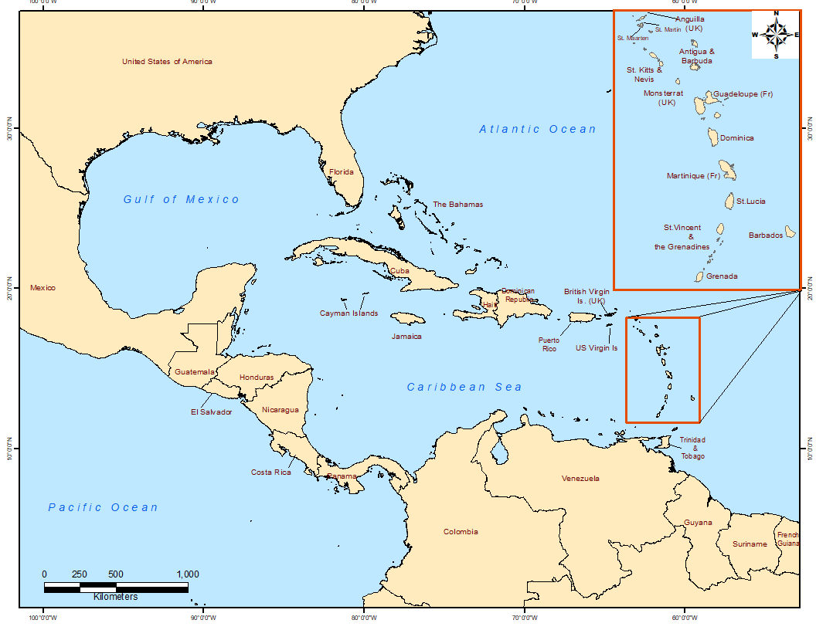
Territories
10 English Speaking countries
Antigua & Barbuda, Barbados, Belize, The Bahamas, Grenada, Guyana, Jamaica, Saint Lucia, Trinidad & Tobago, USA
10 Spanish Speaking countries
Colombia, Costa Rica, Cuba, Dominican Republic, Honduras, Panama, Guatemala, Mexico, Nicaragua, Venezuela

Slide 13
Regulations, Standards and Criteria
Water Quality Regulations are generally prioritised human health and environmental quality
Environmental Quality Standards (EQS) are defined concentrations of parameters existing in a receiving body that do not represent a significant risk to human health or the environment.
Effluent limitations establish limits or quality criteria that aim to ensure that after the effluent enters the receiving environment waters, the ambient water quality standards established for that receiving water body are not exceeded.
Maximum Permissible Limits (MPL) are measures of the concentration or load of parameters that characterise an effluent or pollutant that, when exceeded, causes or has the potential to cause harmful effects to human health or the environment. MPLs applied at point of discharge
When a group of standards or MPLs are applied to a water body with a designated use or purpose, they form Water Quality Criteria. Such criteria are used to determine compliancy with respect to established regulations

Slide 14
LBS Protocol Discharge Limits
Discharges into Class I Waters
Parameter | Effluent Limits
Total Suspended Solids | 30 mg/l*
Biochemical Oxygen Demand (BOD₅) | 30 mg/l
pH | 5-10 pH units
Fats, Oil and Grease | 15 mg/l
Faecal Coliform (Parties may meet effluent limitations either for faecal coliform or for E. coli (freshwater) and enterococci (saline water).) | Faecal Coliform: 200 mpn/100 ml; or a. E. coli: 126 organisms/100ml; b. enterococci: 35 organisms/100 ml
Floatables | not visible
* Does not include algae from treatment ponds
Discharges into Class II Waters
Parameter | Effluent Limits
Total Suspended Solids | 150 mg/l*
Biochemical Oxygen Demand (BOD₅) | 150 mg/l
pH | 5-10 pH units
Fats, Oil and Grease | 50 mg/l
Floatables | not visible
* Does not include algae from treatment ponds

Slide 15
Before we move on…

Slide 16
Existing Frameworks for Wastewater Discharge
CHALLENGES:
Minimal response to Questionnaire (Bdos, Belize, Guyana, Honduras, Jamaica, T&T, USA)
Desk study – Limited to online information, verification, obsolete or up to date
Currently there are some countries without established Regulations for wastewater discharge or they have not yet established specific limits for N and P compounds in wastewater discharges (domestic and/or industrial).
Distinctions within Regulations for domestic wastewater versus industrial effluents are not always clear or not established
Variety between the forms of nutrient compounds/parameters being measured across countries. (Nitrate / NO₃ / N-NO₃)

Slide 17
ANTIGUA AND BARBUDA
The Water Quality and Criteria Guidelines (Schedule VII, Section 64 (2)) of the Environment Protection and Management Act, 2019 (EPMA)
 | Parameter (mg/L)
Application | Nitrate (as NO₃⁻) | Nitrite (as NO₂⁻) | Total Nitrogen (N) | Total Phosphorus (P)
*Protection of coastal waters (Class A, Class B) Aquatic Life and Human Health | 50 | 3
EQS for Coastal Waters |  |  | 0.4 (Class AA, A) 0.8 (Class B) | 0.025 (Class AA, A) 0.5 (Class B)

Slide 18
BARBADOS
The Marine Pollution Control Act 1998 - Marine Pollution Control (Discharge) Regulations are currently being drafted
Environmental Protection Dept – Table of Prohibited Concentration
Application | Parameter (mg/L)
 | Total Nitrogen | Total Phosphorus
End of Pipe Standards | 5 (Class 1) 45 (Class 2) | 1 (Class 1) 10 (Class 2)

Slide 19
BELIZE
Environmental Protection Act 2011
The Environment Protection (Effluent Limitations) Regulations, 2003
The Environment Protection (Effluent Limitations) (Amendment) Regulations, 2009
Regulation | Application | Nitrate (mg/L) | Phosphate (mg/L) | Ammonia (mg/L)
Effluent Limitation Regulations, 2009 First Schedule | Food Processing, Garment, Poultry, Brewery Sugar Processing, etc | 10 | 5
 | Fish Processing | 10 | 30
 | Dairy Industry | 30 | 5
 | Rum Refinery, Shrimp Processing, Soft Drink Bottling | 10 | 1
Second Schedule | For Other Industries or Commercial Activities | 3 (as NO) | 5 (as PO) | 1 (as NH₄)

Slide 20
JAMAICA
National Resources Conservation Authority (NCRA) Act 1991
The Natural Resources Conservation (Wastewater and Sludge) Regulations 2013
Application | Nitrate (mg/L) | Phosphate (mg/L) | Ammonia/Ammonium (mg/L) | Total Nitrogen (mg/L)
Sewage Effluent Standards for Existing Plants | 30 (as- NO₃-N ) | 10 (as PO₄-P)
Sewage Effluent Standards for Plants other than Existing Plants |  | 4 (as PO₄-P) |  | 10
Trade Effluent Standards | 10 (as NO₃) | 5 (as PO₄) | 1.0 (measured as NH₄)

Slide 21
SAINT LUCIA
Saint Lucia Bureau of Standards (SLBS) developed the Guidelines for Recreational Water Quality (SLNS 83: 2016)
Application | Nitrate (mg/L) | Phosphate (mg/L) | Total Nitrogen (mg/L) | Total Phosphorus (mg/L)
Effluent limits for discharges into Class I Waters¹ |  |  | 5 | 1
EQS for Recreational Waters | 0.0098 (as NO₃-N) | 0.00248 (as PO₄-P) | 0.1 | 0.015

Slide 22
TRINIDAD AND TOBAGO
Environmental Management Act, 2000
The Water Pollution Rules (WPR), 2019
Receiving Environment | Ammoniacal Nitrogen as NH₃-N (mg/L) | Total Phosphorus as P (mg/L)
Inland Surface Water | 10 | 5
Coastal nearshore | 10 | 5
Marine Offshore | 10 | 5
Environmentally Sensitive Waters | 0.1 | 0.1
Ambient Water Quality Standards - Marine | Nitrate (mg/L) | Total Phosphate (mg/L) | Ammonia (mg/L)
Protection of Aquatic Life & Aquatic Ecosystems | 10 | 0.1 | 0.5
Recreation | 10 | 0.5 | 0.5

Slide 23
USA (Florida)
Clean Water Act
Florida Surface Water Quality Standards (62-302.530)
Florida Surface Water Quality Standards | Nitrate (mg/L) | Elemental Phosphorous (mg/L) | Total Ammonia Nitrogen (mg/L)
Class I - Potable Water | 10 |  | 30 Day Average
Class II - Shellfish Propagation & Harvesting | 10 | 0.0001 | 30 Day Average
Class III - Predominantly Marine |  | 0.0001 | 30 Day Average

Slide 24
SPANISH SPEAKING COUNTRIES
Country | Wastewater Source | Receiving body | Parameters (mg/L)
 |  |  | P or TP | P0₄³⁻ | P-P0₄³⁻ | N or TN | TKN | NO₃⁻ | N-NO₃⁻ | NO₂⁻ | N-NO₂⁻ | N-NH₃ | N-NH₄⁺ | N-NH₄⁺ + NO₃
Colombia | Domestic wastewater and industrial, commercial and service activities. | Marine waters | 0.4 |  | 0.3 | 1 |  |  | 0.1 |  | 0.02 | 0.3
Honduras | Wastewater (their origin is not specified) | Receiving body | 5 |  |  |  | 30 |  |  |  |  | 20
Panamá | All liquid effluents from domestic, commercial, industrial, and institutional activities. | Continental and marine waters | 10 |  |  | 15 |  | 10 |  |  |  | 3
México | Wastewater (their origin is not specified) | Marine zones | 15 |  |  | 25
Venezuela | For all wastewater discharges. (It does not specify its type). | Marine and coastal environment | 10 |  |  | 40

Slide 25
SPANISH SPEAKING COUNTRIES
Country | Wastewater Source | Receiving body | Parameters (mg/L)
 |  |  | P or TP | P0₄³⁻ | P-P0₄³⁻ | N or TN | TKN | NO₃⁻ | N-NO₃⁻ | NO₂⁻ | N-NO₂⁻ | N-NH₃ | N-NH₄⁺ | N-NH₄⁺ + NO₃
Guatemala | Municipal wastewater with complete treatment systems, at least, for the two (2) main discharges that are reported without treatment in the inventory. | Receiving bodies, unspecified. | 40 |  |  | 150
 | Municipal wastewater with treatment systems for 60% of discharge |  | 20 |  |  | 70
 | Municipal wastewater with treatment systems for 40% of discharges |  | 10 |  |  | 20
Dominican Republic | Municipal wastewater for populations over 10,000 inhabitants. For minors not determined. | Coastal waters |  |  | 8 |  |  |  |  |  |  |  | 30 | 50

Slide 26
SPANISH SPEAKING COUNTRIES
Country | Wastewater Source | Receiving body | Parameters (mg/L)
 |  |  | P or TP | P0₄³⁻ | P-P0₄³⁻ | N or TN | TKN | NO₃⁻ | N-NO₃⁻ | NO₂⁻ | N-NO₂⁻ | N-NH₃ | N-NH₄⁺ | N-NH₄⁺ + NO₃
Nicaragua | Discharges from sanitary sewer treatment systems | Receiving bodies | 15 |  |  | 45
 | Discharges from domestic wastewater treatment systems |  | 10 |  |  | 30
Cuba | Sewage water (Does not specify the typology). | Marine areas of ecological conservation zones or protected areas. (Class A). | 5 |  |  |  | 10
 |  | Marine areas where fishing takes place (Class C). | 7 |  |  |  | 20
 |  | Marine areas whose waters are for industrial use (Class D). | 10 |  |  |  | 40
 |  | Marine areas in bays where maritime-port activity takes place (Class E). | 5 |  |  |  | 20
 |  | Marine areas in bays where maritime-port activity takes place (Class F). | 10 |  |  |  | 40

Slide 27
Existing N and P Limits in WCR

Slide 28
Key Observations in WCR
All countries have established legislation that prohibits wastewater discharge into coastal waters.
Twelve countries (60%) have established MPLs for nutrients in wastewater discharge
Significant variation in the forms of N and P compounds being monitored by countries in the region. Limited uniformity in parameters being measured.
Disparity in the ranges of concentrations in similar parameters
Most countries are measuring nutrient/pollutant concentrations vs load (flow x concentration)

Slide 29
Potential Recommendations
Nutrients compounds proposed are Total Nitrogen (TN) and Total Phosphorus (TP)
These parameters include all forms of potential N and P compounds
Avoids potential inaccuracies regarding the forms of nutrients measured
A distinction should be made for wastewater sources – Separate limits for TN and TP should be established for Domestic and Industrial wastewater
Separate limits for domestic wastewater discharges Class I and Class II waters (Future consideration of Industrial effluents)
Proposed limits should be in the form of concentration to allow for easier integration

Slide 30
Thank You
Email: mnarcis@ima.gov.tt
http://www.ima.gov.tt/rac-ima/

